Slide 1

Breadth-First Search w/predecessors
The alternative to storing whole paths is to store the predecessor of a node in the breadth-first tree.
Whenever you discover a new (white, blue) node, mark the node from which you have discovered it as the predecessor.
Suppose you have V nodes and E edges in a graph.
First, you need to initialize the problem O(V) work.
Initialize-search( G, s ) // s is start node
for each node v ∈ G.V
v.d = ∞
v.π = ∅
s.d = 0 // v.d is the distance from s → v.
s.color = GRAY

Slide 2
BFS pseudocode w/predecessors
Initialize-search( G, s )
Q = ∅
Enqueue( Q, s )
While Q != ∅
u = Dequeue(Q)
foreach v adjacent to u
if v.color=WHITE
v.color=GRAY
v.d=u.d+1
v.π = u
Enqueue(Q,v)
u.color=BLACK

Slide 3
Breadth-First Search Running Time
Every vertex gets enqueued once (when WHITE), and so dequeued once. Enqueue/dequeue are constant time ops, for O(V) queue ops running time.
Every edge gets examined twice (undirected graph) or once (directed graph), with constant time work done on it (check the vertex at the other end). O(E) running time.
Init is O(V).
Running time is O(V) + O(V) + O(E) = O(V+E)

Slide 4
Complexity of Breadth-First Search
Does BFS guarantee to find the shortest path or the path with fewest edges?
What happens on infinite graphs or on graphs with cycles if there is a solution?
What is the time complexity as a function of the length of the path selected?
What is the space complexity as a function of the length of the path selected?

Slide 5
Breadth-First Search & Shortest Paths
BFS yields the shortest path from the source vertex to all other vertices.
Shortest path in the sense of numbers of edges.
Proof is not too hard, but it is too long to go over.

Slide 6
BFS on disconnected graphs
Traditionally, BFS is only done on that portion of a graph which is reachable from the source node.
There are uses of depth-first-search for non-connected graphs, done later.
BFS generates a predecessor subgraph.

Slide 7
Predecessor Subgraph
For graph G = (V,E) with source vertex s, the predecessor subgraph is G_{π} = (V_{π}, E_{π} )
V_{π}, = {v∈V : v.π ≠ ∅} ∪ {s}
E_{π} = { (v.π ,v) : v ∈ V_{π} - {s} }
That is, it has all the vertices reachable from s, plus s, and all edges that grayed a white vertex.
In the original graph E, all edges in E_{π} are called tree edges.
The other edges in E are simply called non-tree edges.

Slide 8
Breadth-First Tree
Theorem: G_{π} = (V_{π}, E_{π}) is the breadth-first shortest-path tree for graph G = (V,E).
Proof outline:
It forms a tree because it only contains edges (E_{π}) that found a white node, so there are no cycles.
The edges in E_{π} were found using BFS
BFS finds shortest paths

Slide 9
Lowest-Cost-First Search/Dijkstra’s Algorithm
Sometimes there are costs associated with arcs. The cost of a path is the sum of the costs of its arcs.
An optimal solution is one with minimum cost.
At each stage, lowest-cost-first search selects a path on the frontier with lowest cost.
This algorithm assumes all edges have non-negative cost.
The frontier is a priority queue ordered by path cost.
It finds a least-cost path to a goal node.
When arc costs are equal, it reduces to BFS.

Slide 10

LCFS/Dijkstra II
Called Lowest-Cost-First search if you are searching for a specific node and plan to stop when you find it.
Called Dijkstra’s Algorithm when you plan to search entire graph.
This means the distances to the discovered-but-unfinished nodes can change partway through the algorithm.
All that matters is the nearest unfinished node to the start.
This suggests using a heap to keep the information.

Slide 11
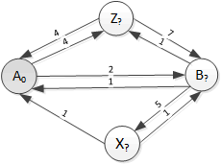
LCFS Example 1: Step a
. Node | Dist from start | Prev Node | Queue after processing node
 |  |  | Node at Head | Dist from start | Prev node | Node | Dist from start | Prev node | Node | Dist from start | Prev node
(init) |  |  | A | 0

Slide 12
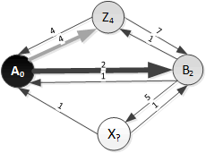
LCFS Example 1: Step b
. Node | Dist from start | Prev Node | Queue after processing node
 |  |  | Node at Head | Dist from start | Prev node | Node | Dist from start | Prev node | Node | Dist from start | Prev node
(init) |  |  | A | 0
A | 0 | - | B | 2 | A | Z | 4 | A

Slide 13
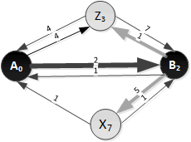
LCFS Example 1: Step c
. Node | Dist from start | Prev Node | Queue after processing node
 |  |  | Node at Head | Dist from start | Prev node | Node | Dist from start | Prev node | Node | Dist from start | Prev node
(init) |  |  | A | 0
A | 0 | - | B | 2 | A | Z | 4 | A
B | 2 | A | Z | 3 | B | X | 7 | B

Slide 14
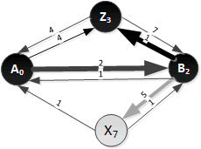
LCFS Example 1: Step d
. Node | Dist from start | Prev Node | Queue after processing node
 |  |  | Node at Head | Dist from start | Prev node | Node | Dist from start | Prev node | Node | Dist from start | Prev node
(init) |  |  | A | 0
A | 0 | - | B | 2 | A | Z | 4 | A
B | 2 | A | Z | 3 | B | X | 7 | B
Z | 3 | B | X | 7 | B

Slide 15
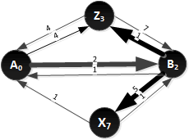
LCFS Example 1: Step e
. Node | Dist from start | Prev Node | Queue after processing node
 |  |  | Node at Head | Dist from start | Prev node | Node | Dist from start | Prev node | Node | Dist from start | Prev node
(init) |  |  | A | 0
A | 0 | - | B | 2 | A | Z | 4 | A
B | 2 | A | Z | 3 | B | X | 7 | B
Z | 3 | B | X | 7 | B
X | 7 | B

Slide 16
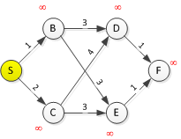
LCFS/Dijkstra Example 2
Node | D(S) | Prev | Root | D(S) | Prev | Node | D(S) | Prev | Node | D(S) | Prev
1st |  |  | S | 0
S | 0 |  | B | 1 | S | C | 2 | S

Slide 17
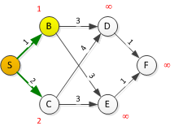
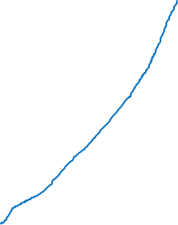
Node | D(S) | Prev | Root | D(S) | Prev | Node | D(S) | Prev | Node | D(S) | Prev
1st |  |  | S | 0
S | 0 |  | B | 1 | S | C | 2 | S
B | 1 | S | C | 2 | S | D | 4 | B | E | 4 | B

Slide 18
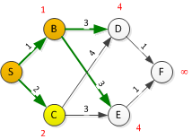

Node | D(S) | Prev | Root | D(S) | Prev | Node | D(S) | Prev | Node | D(S) | Prev
1st |  |  | S | 0
S | 0 |  | B | 1 | S | C | 2 | S
B | 1 | S | C | 2 | S | D | 4 | B | E | 4 | B
C | 2 | S | D | 4 | B | E | 4 | B

Slide 19
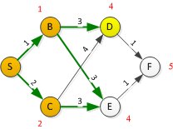

Node | D(S) | Prev | Root | D(S) | Prev | Node | D(S) | Prev | Node | D(S) | Prev
1st |  |  | S | 0
S | 0 |  | B | 1 | S | C | 2 | S
B | 1 | S | C | 2 | S | D | 4 | B | E | 4 | B
C | 2 | S | D | 4 | B | E | 4 | B
D | 4 | B | E | 4 | B | F | 5 | D

Slide 20
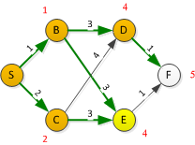

Node | D(S) | Prev | Root | D(S) | Prev | Node | D(S) | Prev | Node | D(S) | Prev
1st |  |  | S | 0
S | 0 |  | B | 1 | S | C | 2 | S
B | 1 | S | C | 2 | S | D | 4 | B | E | 4 | B
C | 2 | S | D | 4 | B | E | 4 | B
D | 4 | B | E | 4 | B | F | 5 | D
E | 4 | B | F | 5 | D

